Slide 1
3D Face Restructruction for in-the-wild DFER
汇报人： Yin Chen
汇报时间： 2024.01.19

Slide 2
Dynamic Facial Expression Recognition in the Wild
Definition
It is a task of identifying and classifying facial expressions from video clips or images captured in uncontrolled, real-world environments.
Challenge
Variations in lighting
Occlusion
Head movement (Motion)
Complexity of expression
Notes:
这一页介绍自己总结自己这一周做了哪些工作 （一周的时间不长也不短，你平时可以随意摸鱼，当时当你回顾这一周的工作，发现你学到的或者做到的对不起这一周的时间，就应该反思了）

Slide 3
Head vs. Expression Motion
Head Motion
Nature: Movement/rotation of the entire head (tilting, nodding, turning).
Impact: Alters appearance of facial features due to viewpoint changes and potential occlusions.
Challenge: Recognize expressions accurately from various angles and under different lighting conditions.
Notes:
Dynamic Facial Expression Recognition: Posture vs. Expression Changes
Posture Change (Head Movement)
Nature: Movement/rotation of the entire head (tilting, nodding, turning).
Impact: Alters appearance of facial features due to viewpoint changes and potential occlusions.
Challenge: Recognize expressions accurately from various angles and under different lighting conditions.
Expression Change (Facial Muscle Movement)
Nature: Movement of facial muscles to convey emotions (e.g., eyebrow raising, smiling, frowning).
Impact: Alters shape and position of facial features without changing head orientation.
Challenge: Capture and interpret subtle, transient facial muscle movements for emotion identification.

Slide 4
Posture vs. Expression Changes
Expression motion
Nature: Movement of facial muscles to convey emotions (e.g., eyebrow raising, smiling, frowning).
Impact: Alters shape and position of facial features without changing head orientation.
Challenge: Capture and interpret subtle, transient facial muscle movements for emotion identification.

Slide 5
3D Face Reconstruction
Definition
3D Face Reconstruction refers to the process of creating a three-dimensional digital representation of a human face
Learning paradigm
1、3D Morphable Model (3DMM) parameters regression
Concept: Utilizes a statistical model created from a comprehensive database of 3D face scans. The 3DMM represents various facial shapes and textures through adjustable parameters.
How It Works: Algorithms learn to map 2D image features onto 3DMM parameters, enabling the reconstruction of 3D facial models from single or multiple 2D images.
Applications: Widely used in facial recognition, animation, and areas requiring accurate facial models
Notes:
D Morphable Model (3DMM) 参数回归：
概念：3DMM是一种基于统计学的方法，它使用大量详细的3D扫描来创建面部的标准化模型。这些模型能够通过调整一组参数来表示各种面部形状和纹理。
工作原理：在3DMM参数回归中，算法学习将2D图像特征映射到3DMM参数上。通过这种方式，可以从单个或多个2D图像重建出3D面部模型。
应用：这种方法广泛用于面部识别、动画制作以及其他需要精确面部模型的领域。
稠密顶点回归（Dense Vertices Regression）：
概念：这种方法直接预测面部模型每个顶点的三维坐标，而不是依赖于参数化的模型。
工作原理：利用深度学习，特别是卷积神经网络（CNNs），直接从图像中学习每个顶点的三维位置。这种方法通常需要大量的标记数据，即已知3D坐标的面部图像。
应用：稠密顶点回归在处理高度个性化的面部特征或复杂表情时非常有效。

Slide 6
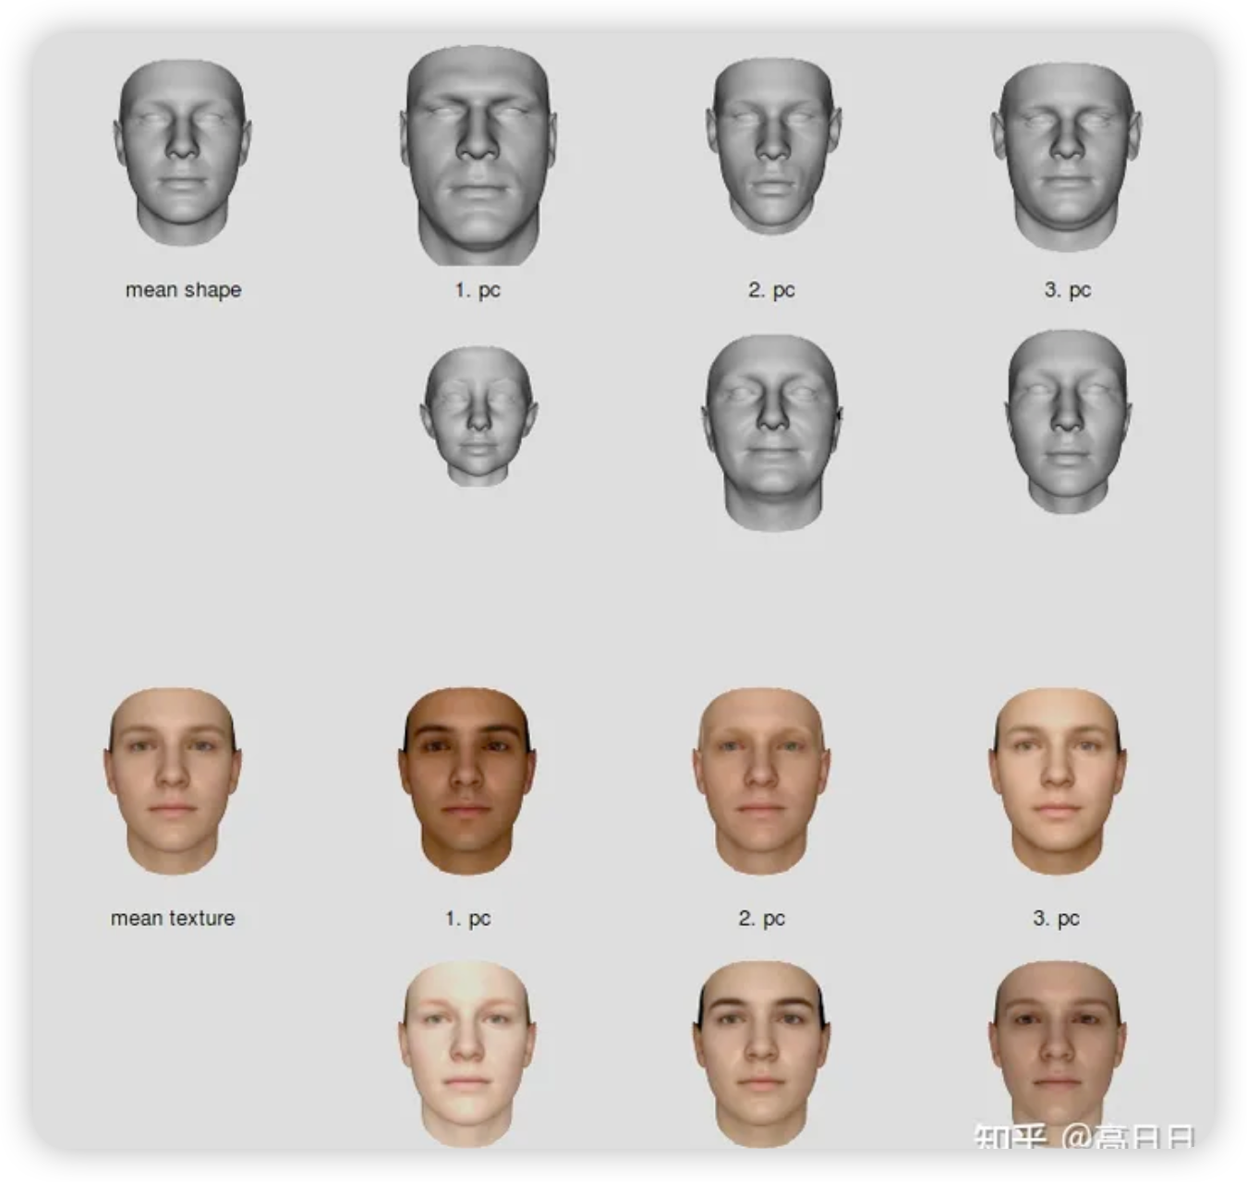
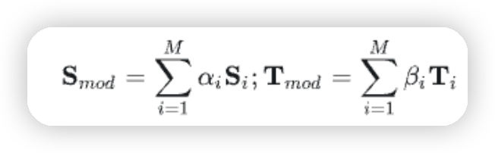
3D Face Reconstruction
[数字人基础 | 人脸3DMM的前世今生 - 知乎](https://zhuanlan.zhihu.com/p/634381271)
Notes:
如下图所示, 对于任意给定的一张 2D 人脸图片, 其 3D 人脸可以由 3DMM 的一系列**人脸基向量**进行加权组合, 其中 M 表示基向量的数量, $\alpha_i$表示控制 Shape 的每个基向量的系数($β_i$) 表示控制 Texture 的基向量的系数), 意味着在特定**人脸基向量**上与 mean shape/texture 的距离(变形)有多远(比如$\alpha_1= 0.8$，这意味着特征 1 来说, 其人脸整体会**更小**, 皮肤颜色**更白**)

Slide 7
3D Face Reconstruction
Learning paradigm
2、Dense vertices regression
Concept: Directly predicts the three-dimensional coordinates of each vertex on the facial model, bypassing parametric models.
How It Works: Employs deep learning, especially Convolutional Neural Networks (CNNs), to learn the 3D positions of vertices directly from images. This method often requires extensive labeled data.
Applications: Highly effective for capturing detailed, individual facial features and complex expressions.
Key Differences
3DMM Parameter Regression offers robustness against varying lighting and poses but may have limitations in capturing fine details.
Dense Vertices Regression excels in detailing and individualization but demands high-quality and diverse training data
Notes:
D Morphable Model (3DMM) 参数回归：
概念：3DMM是一种基于统计学的方法，它使用大量详细的3D扫描来创建面部的标准化模型。这些模型能够通过调整一组参数来表示各种面部形状和纹理。
工作原理：在3DMM参数回归中，算法学习将2D图像特征映射到3DMM参数上。通过这种方式，可以从单个或多个2D图像重建出3D面部模型。
应用：这种方法广泛用于面部识别、动画制作以及其他需要精确面部模型的领域。
稠密顶点回归（Dense Vertices Regression）：
概念：这种方法直接预测面部模型每个顶点的三维坐标，而不是依赖于参数化的模型。
工作原理：利用深度学习，特别是卷积神经网络（CNNs），直接从图像中学习每个顶点的三维位置。这种方法通常需要大量的标记数据，即已知3D坐标的面部图像。
应用：稠密顶点回归在处理高度个性化的面部特征或复杂表情时非常有效。

Slide 8
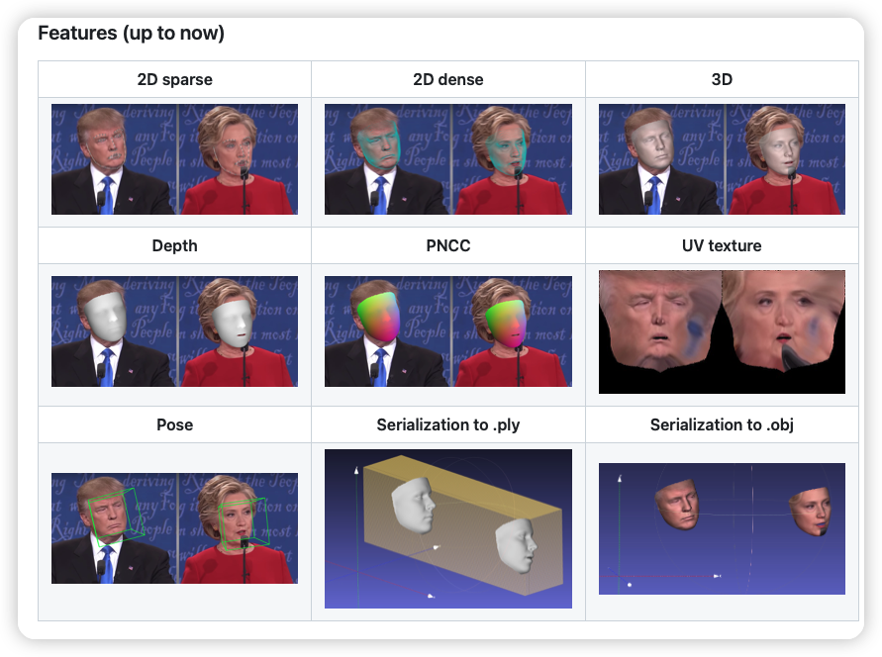
How to leverage 3D Face Restructruction for for in-the-wild DFER
Features of 3D face restructruction

Slide 9
如何和 DFER结合起来辅助 DFER
遇到的困难
后续计划

